Slide 1

IMDB Movie Analysis

Slide 2
Project Description :
This project mainly focused on movie analysis which is helpful for Movie producers,directors, investors to understand the important factors to make successful movies and future projects.
In this analysis, We will be doing Data cleaning which includes missing values,removing duplicates etc.
Data Analysis where we will analyse relevant factors based on IMDB movies dataset with 5 "WHYS '' approach to uncover the root cause. We will also create a report and data story to understand actionable insights.

Slide 3
Approach :
We will be doing regular Data cleaning and Analysis with 5 "WHYS" approach like given
below -
Q1: "Why do movies with higher budgets tend to have higher ratings?"
Ans: They can afford better production quality.
Q2: "Why does better production quality lead to higher ratings?"
Ans: It enhances the viewer's experience.
Q3: "Why does an enhanced viewer experience lead to higher ratings?"
Ans: Viewers are more likely to rate a movie highly if they enjoyed watching it.
Q4: "Why are viewers more likely to rate a movie highly if they enjoyed watching it?"
Ans: Positive experiences lead to positive reviews.
Q5: "Why do positive reviews matter?"
Ans: They influence other viewers' decisions to watch the movie, increasing its popularity and
success.

Slide 4


Tech- Stack Used :
We will be using Google sheet & Excel sheet for data cleaning and making reports based on IMDB movies data.

Slide 5
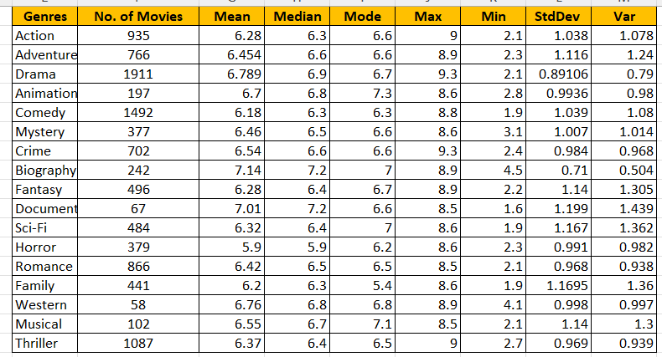
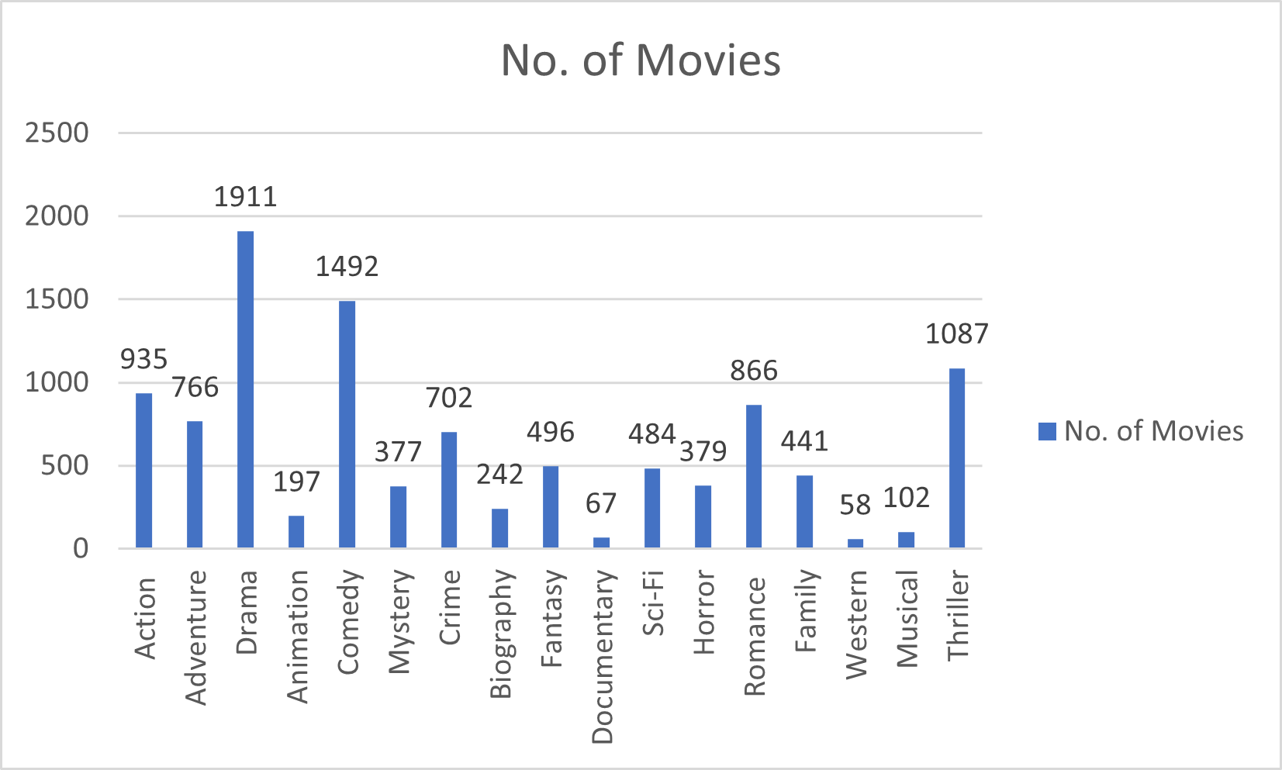
Insights :
Task 1 : Movie Genre Analysis: Analyse the distribution of movie genres and their impact on the
IMDB score.

Slide 6
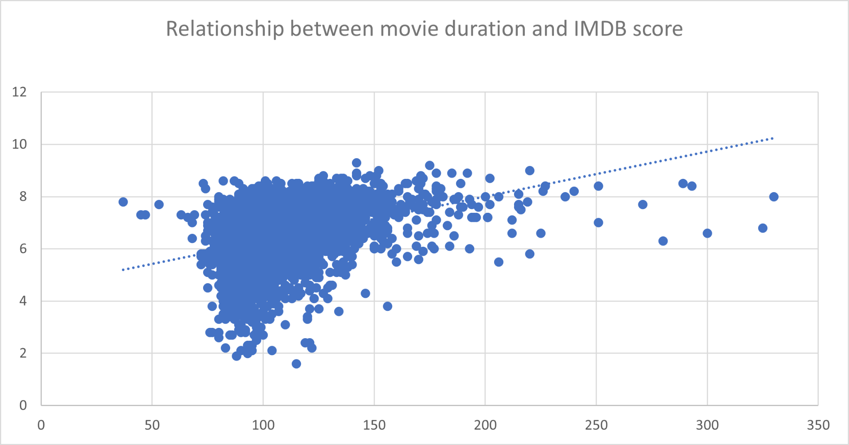
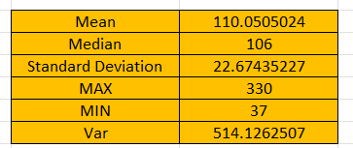
Task 2 : Movie Duration Analysis :
Analyse the distribution of movie durations and its impact on the IMDB score.

Slide 7
Task 3 : Determine the most common languages used in movies and analyse their impact on the IMDB
score using descriptive statistics
Please find the link below to check this task -
https://docs.google.com/spreadsheets/d/1W7JLQEYeeXOxYupAU_1F1pEVwunuMtgy/edit?usp=drive_link&ouid=115986816887265464875&rtpof=true&sd=true

Slide 8
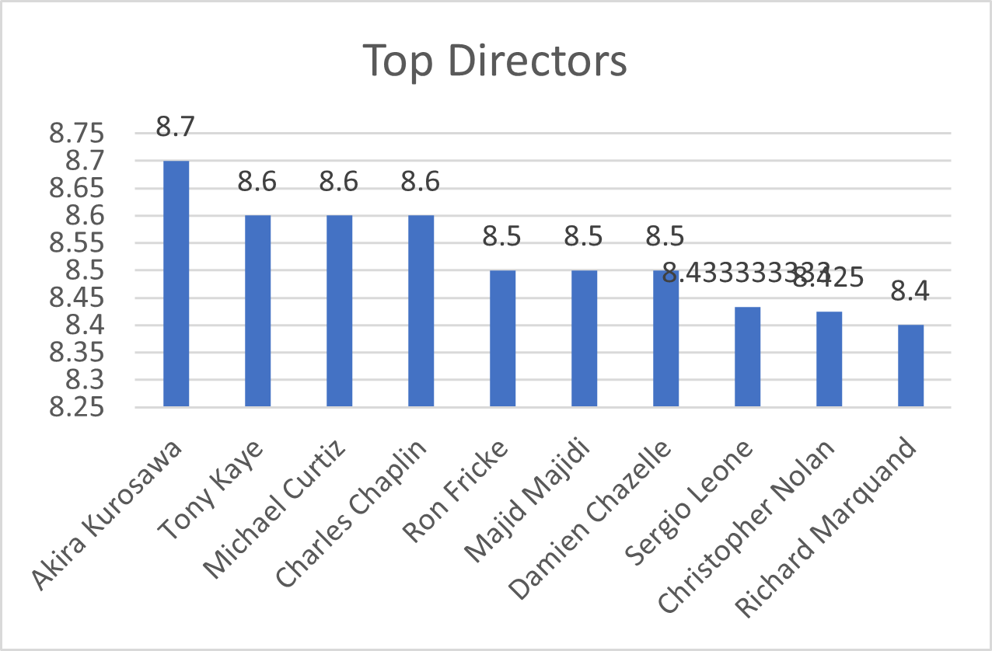
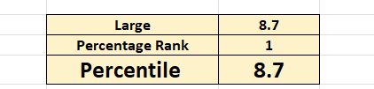
Task 4 : Identify the top directors based on their average IMDB score and analyse their contribution to the
success of movies using percentile calculations.

Slide 9
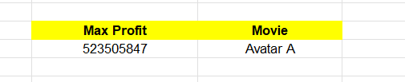
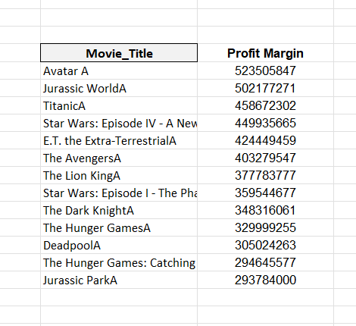

Task 5 : Analyze the correlation between movie budgets and gross earnings, and identify the movies with
the highest profit margin.
Highest Profit Movies
correlation coefficient between movie budgets and gross earnings

Slide 10
Please find below link to check excel calculations & cleaned dataset
Excel Link : TASK ABCD https://docs.google.com/spreadsheets/d/1W7JLQEYeeXOxYupAU_1F1pEVwunuMtgy/edit?usp=drive_link&ouid=115986816887265464875&rtpof=true&sd=true
Excel Link : Task E
https://docs.google.com/spreadsheets/d/13VFsvivPiutX-8hivxweiTNWNa134chm/edit?usp=drive_link&ouid=115986816887265464875&rtpof=true&sd=true

Slide 11
Results :
The IMDB Movie analysis project gave an idea of Descriptive statistics and how to use different graphs. This project gave an idea of how the movie industry is able to understand movie rating impact on movie success.

